Slide 1
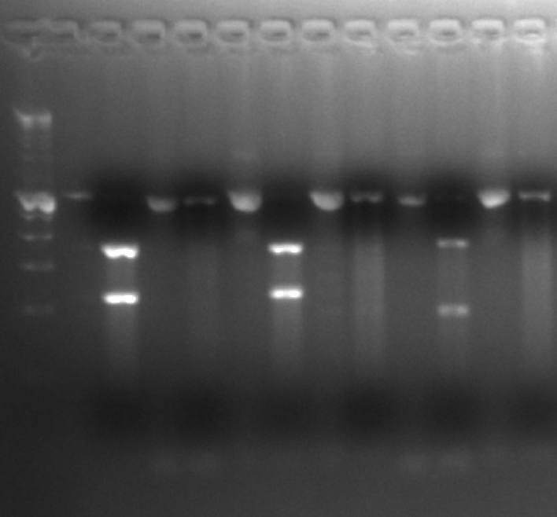
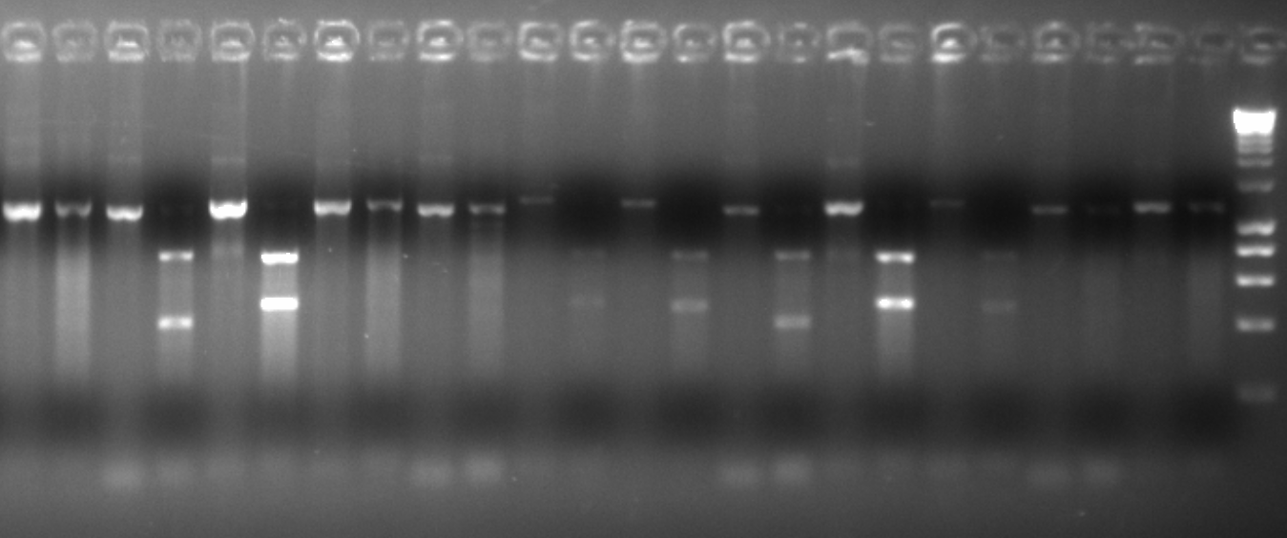
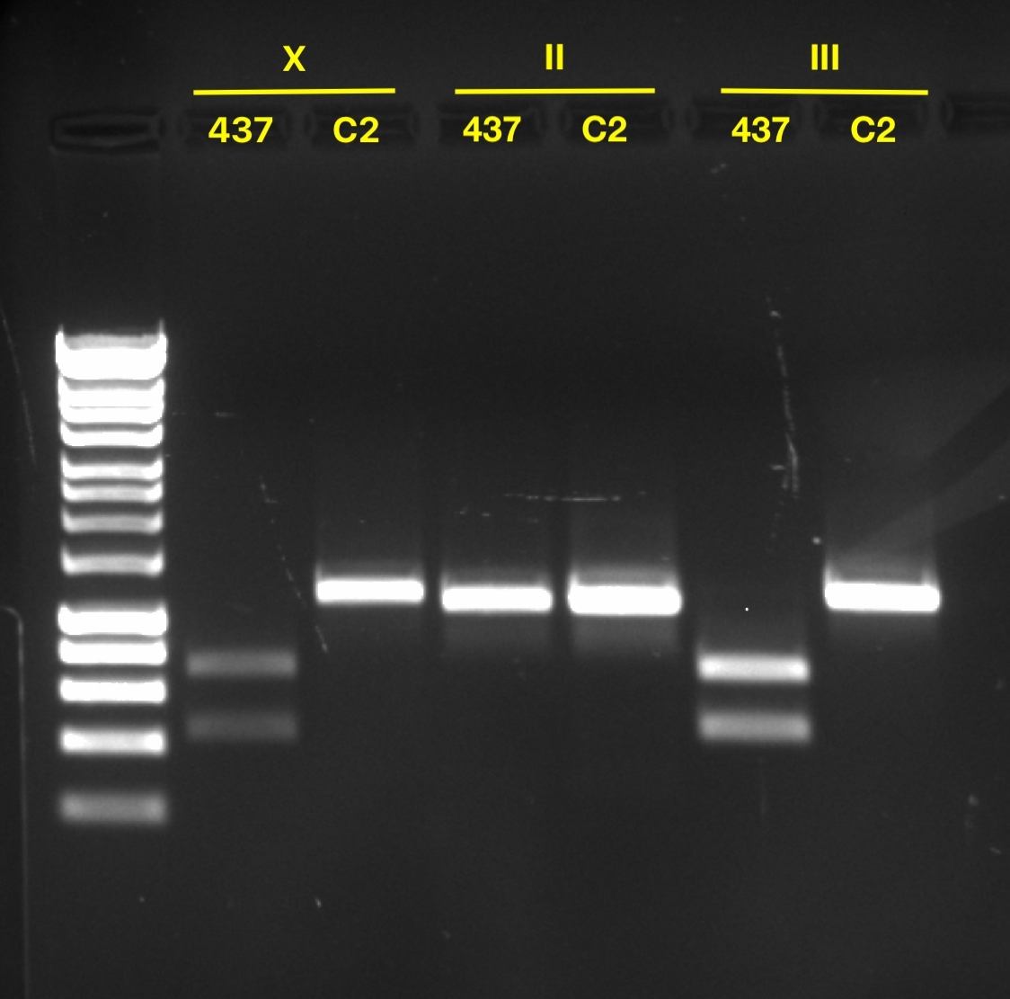
A
Primer | Forward | Reverse | PCR Product Size (bp) | EcoR1 Cut Size 1 (bp) | EcoR1 Cut Size 2 (bp) | Diagnostic choromsome | DGRP-437 | DGRP-892 | X ⁸⁹²; II ⁴³⁷; III ⁸⁹² | X ⁸⁹²; II ⁸⁹²; III ⁴³⁷ | X ⁸⁹²; II ⁴³⁷; III ⁴³⁷ | X ⁴³⁷; II ⁸⁹²; III ⁴³⁷ | X ⁴³⁷; II ⁴³⁷; III ⁸⁹²
X2 | GGATGCGGATAGTCCACCTA | GTTAAGGGTTTGCTGGGACA | 1174 | 451 | 723 | X | Cut | Uncut | Uncut | Uncut | Uncut | Cut | Cut
2L1 | GCTACCCAAAGGCAGATTCA | GTATCTTCGCGGGCTAAATG | 1131 | 394 | 737 | II | Uncut | Cut | Uncut | Cut | Uncut | Cut | Uncut
3L3 | ACTATGCACAGGGGTCGTTC | CTGTGGCATTTTGGTCGAGT | 1195 | 465 | 730 | III | Cut | Uncut | Uncut | Cut | Cut | Cut | Uncut
B
C
L
DGRP-437
DGRP-892
X ⁸⁹²; II ⁸⁹²; III ⁴³⁷
X ⁸⁹²; II ⁴³⁷; III ⁴³⁷
X ⁴³⁷; II ⁸⁹²; III ⁴³⁷
X ⁴³⁷; II ⁴³⁷; III ⁸⁹²
L
X2
2L1
3L3
X2
2L1
3L3
X2
2L1
3L3
X2
2L1
3L3
X2
2L1
3L3
X2
2L1
3L3
U
D
U
D
U
D
U
D
U
D
U
D
U
D
U
D
U
D
U
D
U
D
U
D
U
D
U
D
U
D
U
D
U
D
U
D
L: Bioline HyperLadder™ 1kb, U: undigested; D: EcoR1 digested

